Slide 1
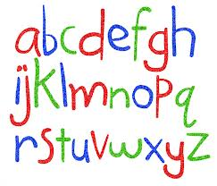
Phonics Screening Check Information
Session
April 2025

Slide 2

Can you read these sentences?
igh carnt doo fonix!
Reellee? ie luv fonix!
Notes:
You are able to read these sentences because of your phonic skills. None of the words are spelt correctly but the phonemes used make the ness sounds for you to read them. Likewise

Slide 3
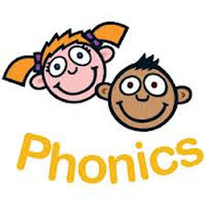
What is the Phonics Screening Check?
Children in Year One throughout the country will be taking part in a phonics screening check during the same week in June. Children in Year Two will also take the check if they did not achieve the required result when they were in Year One. This is a check on their reading only.

Slide 4
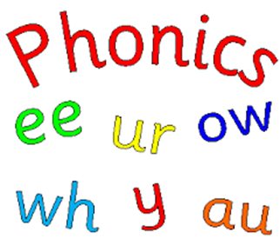
What is it for?
The phonics screening check is designed to confirm whether individual children have learned phonic decoding and blending skills to an appropriate standard.

Slide 5
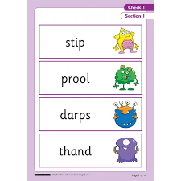
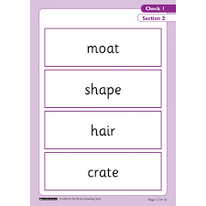
What does that mean?
This means that children have to use only phonics knowledge to work out what the words in the check say. The words are presented on their own, not in sentences, so children have no other clues for working them out.

Slide 6
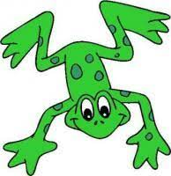
They can only use the skills of recognising and saying the sounds that they see and blending these together to attempt to read the word.
Special Friends,
Fred Talk,
Read the word!
e.g. shop

Slide 7

What happens during the screening?
The check contains 40 words. Each child will sit one to one with a familiar adult and read each word aloud. It will take approximately 10 minutes, although there is no time restriction and children can work at entirely their own pace. The list of words to read contains 20 real and 20 pseudo words.

Slide 8
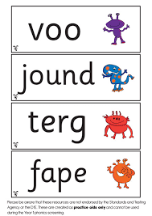
Pseudo Words
The pseudo words will be shown to your child with a picture of an alien. This helps them to know that it will not be a word they have heard in the English language and will sound ‘alien’ to them.

Slide 9


Why are the pseudo words included?
Pseudo words are included because they will be new to all children; they do not favour children with a good vocabulary or visual memory of words.

Slide 10

How is it marked?
The check is scored by one mark being awarded for each word read correctly. As a result children can score up to 40 marks.
Each year a threshold is set by the Government for the expected standard. We do not know in advance what this will be but it has previously been set at 32 marks.

Slide 11

What happens about the results?
Schools use the information and results from the screening to help them reflect on what children have learnt well and what they have found difficult each year. We report all children's scored to the Local Authority who can see how different schools are doing with phonics.
If your child doesn’t reach the expected standard then we will ensure that they receive the right support in Year Two in order to address the areas they find difficult. They will then have another check at the end of Year Two to see how they are progressing.

Slide 12

How will I know the results?
By the end of the Summer Term we will have reported to you about how your child did in the screening, along with reporting on their progress in other curriculum areas. We will tell you’re their score and whether or not this meets the threshold.

Slide 13
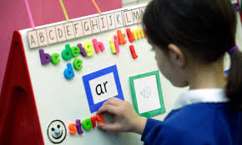
How can I support my child?
You can support your child by continuing to read widely and regularly with them.
Encouraging them to use the strategies for sounding and blending when they encounter new words in reading (remembering to model pure sounds). Special Friends, Fred Talk, Read the Word!
Encouraging them to use sound buttons to help them see the digraphs (special friends!) in words when reading.
Practising reading words out of context.
Playing word reading games and using
websites which support phonic learning.

Slide 14
Useful links
http://www.oxfordowl.co.uk/home/reading-owl/expert-help/the-year-1-phonics-screening-check
https://www.gov.uk/government/publications/phonics-screening-check-sample-materials-and-training-video
www.ictgames.com
www.phonicsplay.co.uk
www.letters-and-sounds.com

